Slide 1
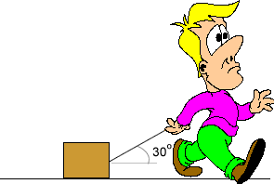

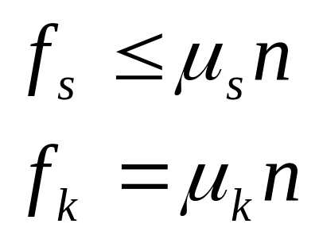
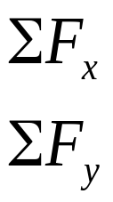
Dynamics
Physics 131
Lecture 9
Random questions
Forces in Equilibrium
Forces causing acceleration
Friction
All found in Young and Freedman, University Physics, chapter 5, section 1 and 2 and problems throughout chapters 4 and 5
Notes:
Today we’ll continue with this but we’ll concentrate on problem solving methods, going through lots of problems. I haven’t got time to go through all types of problems but the ones we do today will give you a good idea of how to do the ones I think will be useful.
Here’s a list of what you need to know from this lecture. You have this information on the handout I have given you. The handout also includes the text book references.

Slide 2
Intuitive way to view resolving forces in any direction
Resolve the following vector into angles. For small angles the component changes little. For 90⁰ component =0.
Fcos45
45º
F
30º
90º
Fcos90=0
Fcos30
cos measures horizontally
sin measures vertically

Slide 3
Example: Find the x component of this vector
Free body diagram – Find the x and y components of this force
y
5N
20º
F_{y}
x
F_{x}
F_{x}=F sinθ or Fcos(90-θ)
=5cos70=1.71N

Slide 4
Difference between Weight and mass
Weight =mg
And depends on the value of acceleration due to gravity.
Mass is the same anywhere.

Slide 5
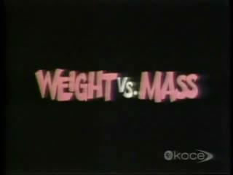

Slide 6
Review
Last lecture we looked at dynamics, specifically:
Forces and the superposition of forces
Newton’s three laws of motion
Static and kinetic friction
Dynamics of circular motion
Problem solving strategies, including free-body diagrams
1st-constant velocity.
2nd F=ma.
3rd Equal and opposite
Notes:
Last lecture we looked at
Forces and the superposition of forces
Newton’s three laws of motion
Static and kinetic friction
Dynamics of circular motion
Problem solving strategies, including free-body diagrams

Slide 7
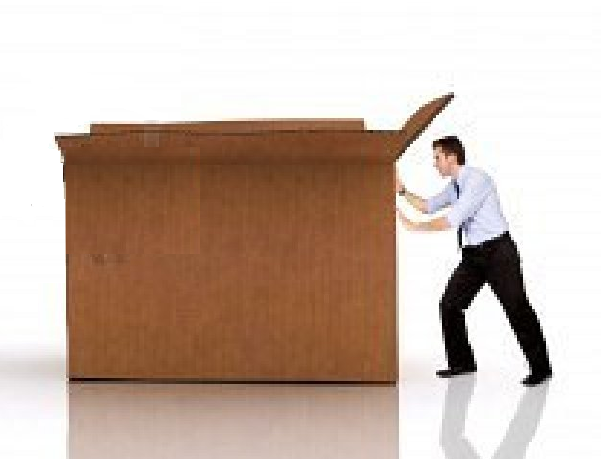
Example: A 20 kg box is sitting on the floor.
If the coefficient of static friction μ_{s}= 0.5 and the coefficient of kinetic friction μ_{k}= 0.4 calculate the force needed to start it sliding, and the force needed to continue the sliding at constant velocity.

Slide 8
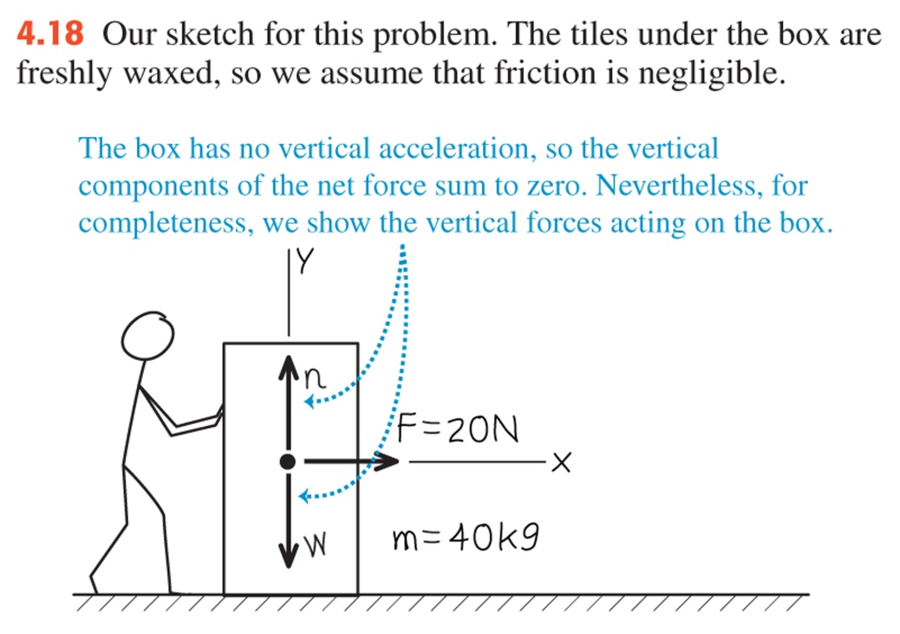
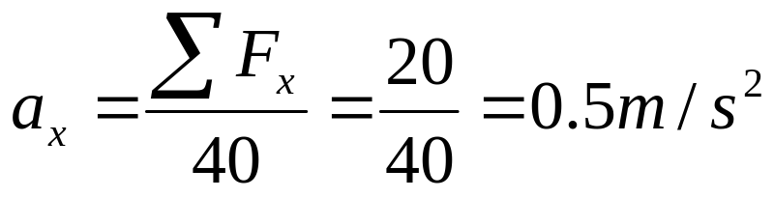
Example 4.4 Determining acceleration from force
A worker applies a constant horizontal force with magnitude 20 N to a box with mass 40 kg resting on a level surface with negligible friction. What is the acceleration of the box ?
Notes:
A worker applies a constant horizontal force with magnitude 20 N to a box with mass 40 kg resting on a level surface with negligible friction. What is the acceleration of the box ?
Here is a picture showing what’s happening. SEE SHEET, problem 5 for rest.

Slide 9
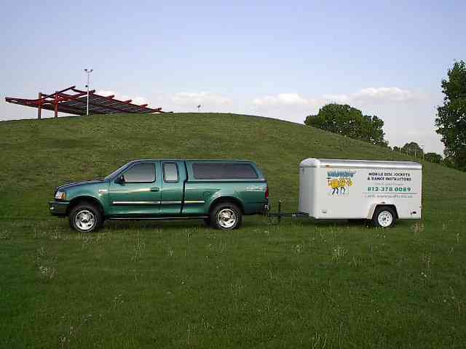
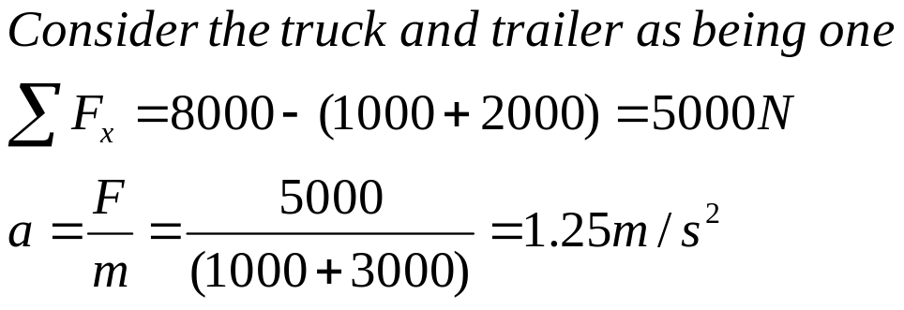
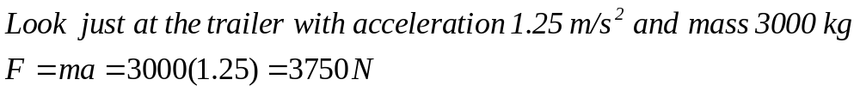
Example: Truck-trailer
A truck of mass 1 000 kg pulls a trailer, of mass 3 000 kg. The frictional force on the truck is 1000 N, on the trailer is 2 000 N, and the truck engine supplies a force of 8 000 N. Calculate the acceleration of the truck and trailer, and the tension T in the tow-bar connection.
Notes:
A truck, A, of mass 1,000 kg pulls a trailer, B, of mass 3000 kg. The frictional force on A is 1000 N, on B is 2000 N, and the truck engine exerts a force of 8000 N on A. Calculate the acceleration of the truck and trailer, and the tension T in the tow-bar connecting A and B.
SEE SHEET, problem 6 ….it involves friction.

Slide 10
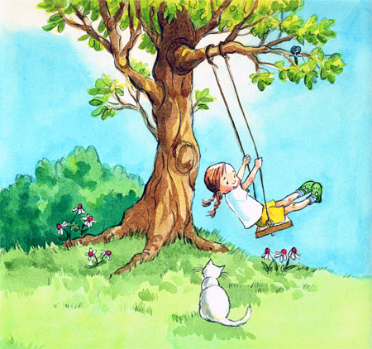
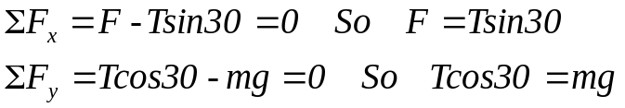
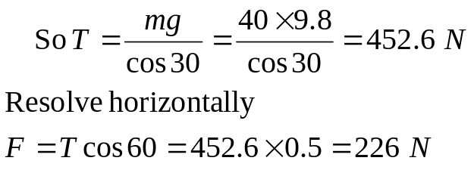
Example: Swing
How much horizontal force needs to be exerted on Karen riding a swing to obtain an angle of 30⁰ to the vertical.
Karen + swing have combined mass of 40kg.
30⁰
T
Free body diagram
F
mg

Slide 11
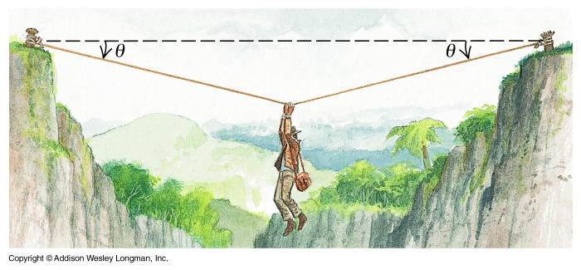
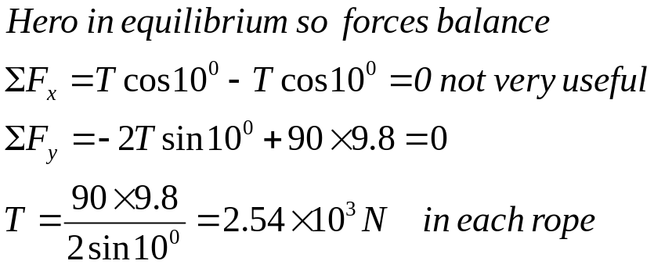
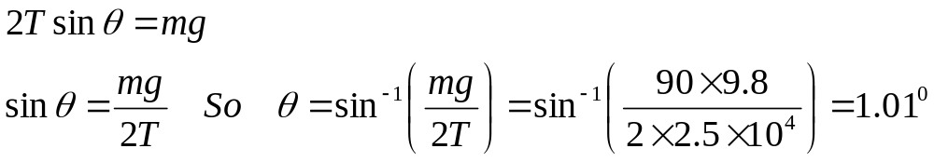
Exercise Q5.3 Forces in equilibrium
An adventurous archaeologist crosses between two rock cliffs by slowly going hand-over-hand along a rope stretched between the cliffs. He stops to rest at the middle. The rope will break if the tension in it exceeds 2.5 x 10⁴ N, and our hero’s mass is 90.0 kg. a) If the angle θ is 10.0⁰, find the tension in the rope.
T
T
mg
b) What is the smallest angle θ if the rope is not to break?.
Notes:
An adventurous archaeologist crosses between two rock cliffs by slowly going hand-over-hand along a rope stretched between the cliffs. He stops to rest at the middle. The rope will break if the tension in it exceeds 2.5 x 10⁴ N, and our hero’s mass is 90.0 kg. If the angle theta is 10.0⁰, find the tension in the rope.
Here is a picture showing what’s happening. SEE SHEET, problem 2 for rest.

Slide 12
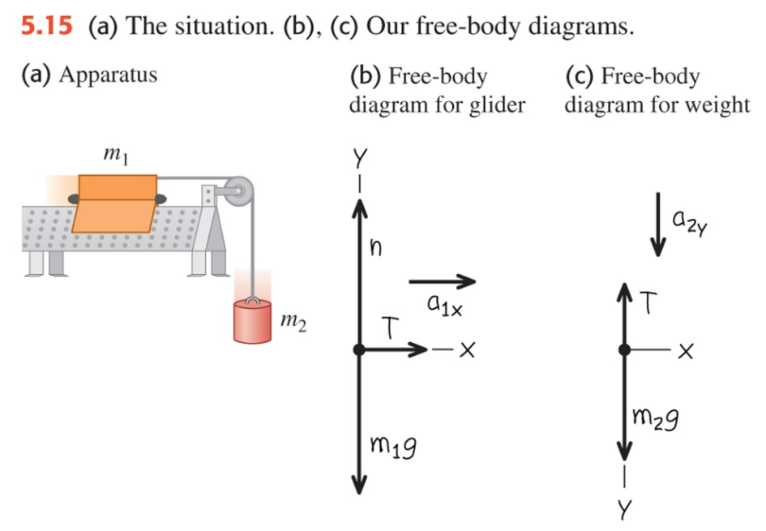
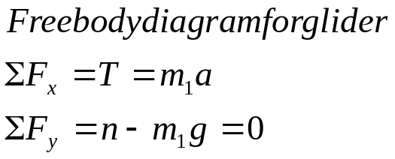
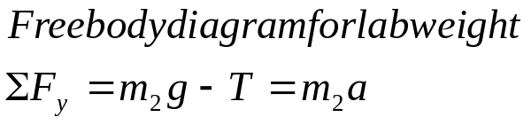
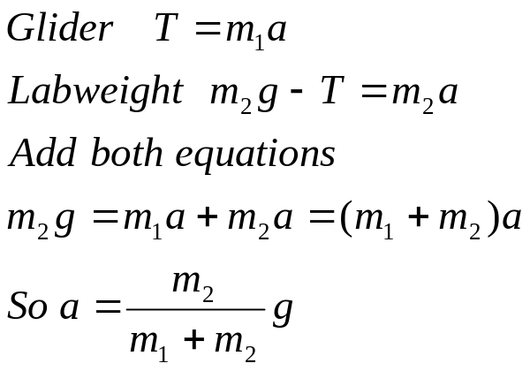
5.12 Two bodies with the same magnitude of acceleration
An air track glider with m₁ moving on a level, frictionless air track in the physics lab is set up as shown. The glider is connected to a lab weight with mass m₂ by a light, flexible, non-stretching string that passes over a small frictionless pulley. Find the acceleration of each body and the tension in the string.
Make +y downwards for labweight

Slide 13
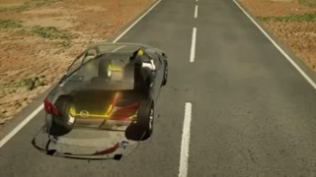

Slide 14
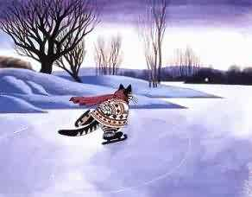
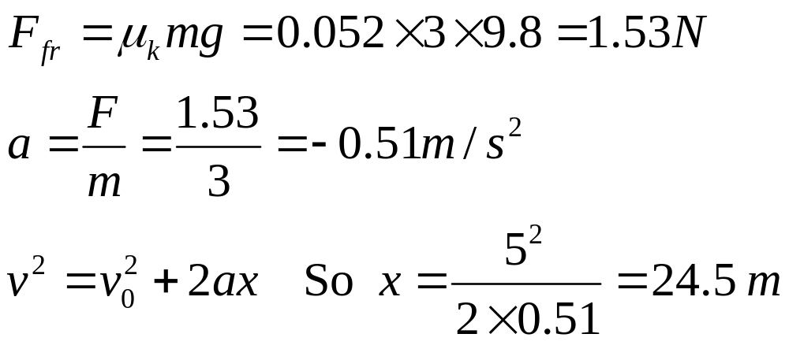
Example: The ice skating cat
A 3 kg cat is pushed out onto a frozen lake at 5 m/s. If the coefficient of friction between the skates and the ice μ_{k}= 0.052, how far will the cat travel before stopping? Hint: calculate friction force first.

Slide 15
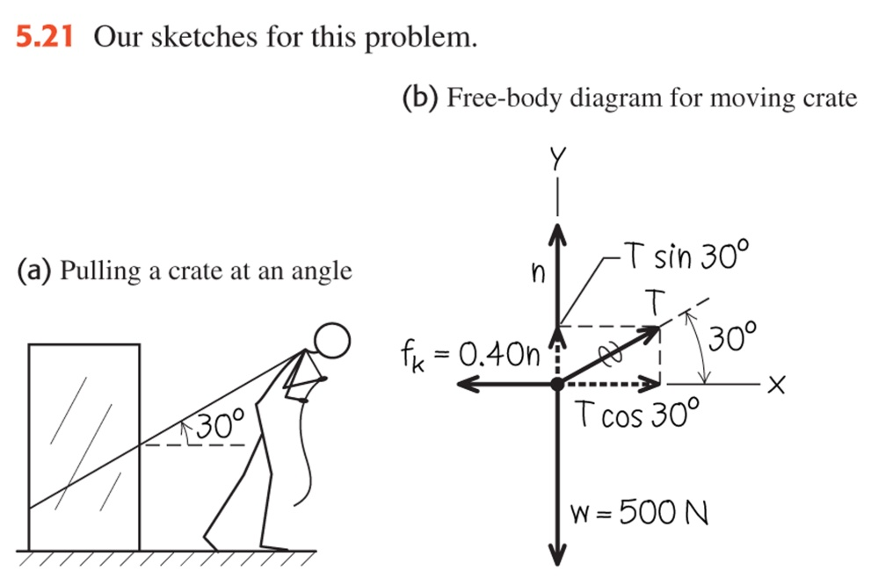
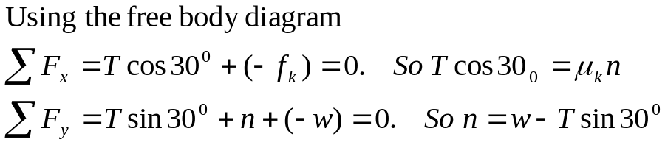

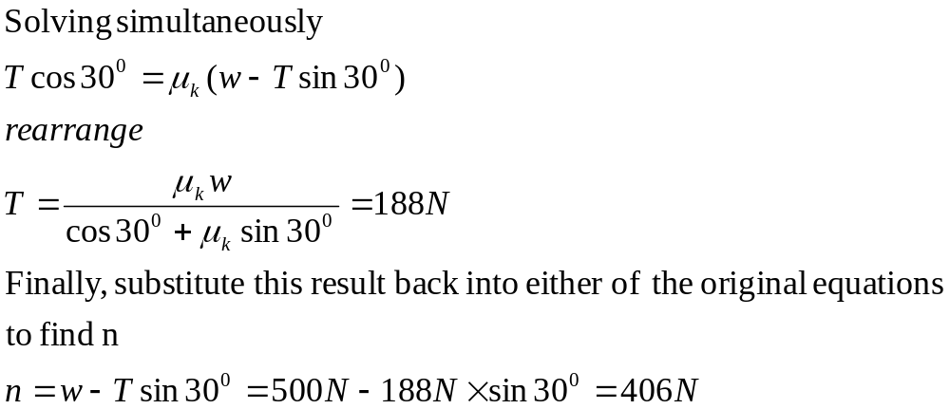
5.15 Minimising kinetic friction
Suppose you try to move a crate by tying a rope around it an pulling upward on the rope at an angle of 30º above the horizontal. How hard do you have to pull to keep the crate moving with constant velocity? Is this easier or harder than pulling horizontally?
Weight of crate =500 N and µ_{k}=0.40

Slide 16
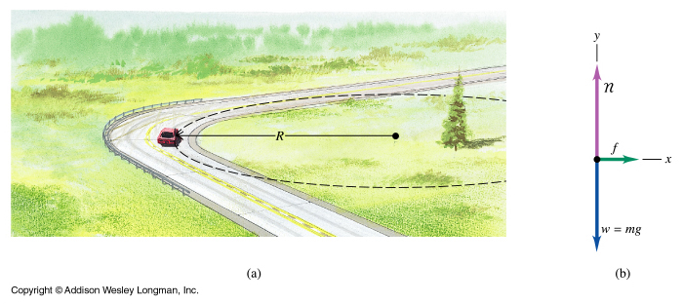
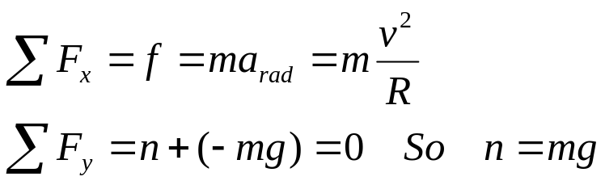
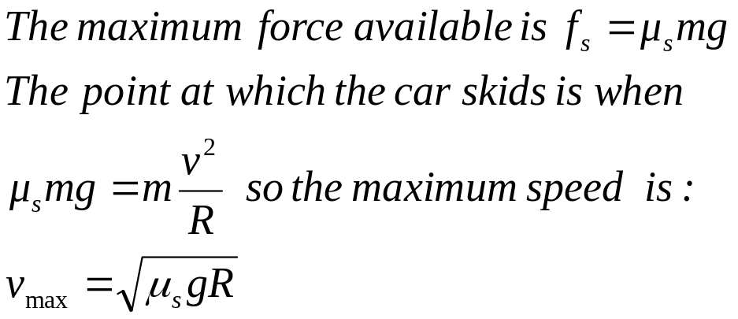
Example 5.22 Rounding a flat curve
A car is rounding a flat, unbanked curve with radius. If the coefficient of friction between the tires and road is µ_{s}, what is the maximum speed v_{max} at which the driver can take the curve without skidding.
Notes:
Now let’s apply this to our car going round a bend. We need a force to keep it in the circle of the bend.
Friction can provide this force.

Slide 17
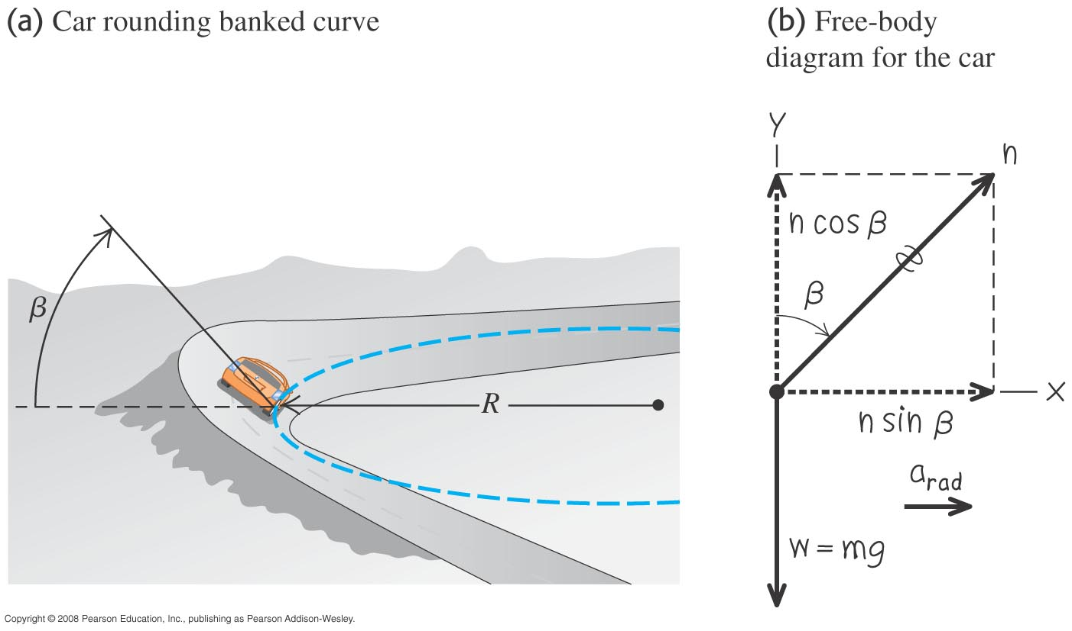
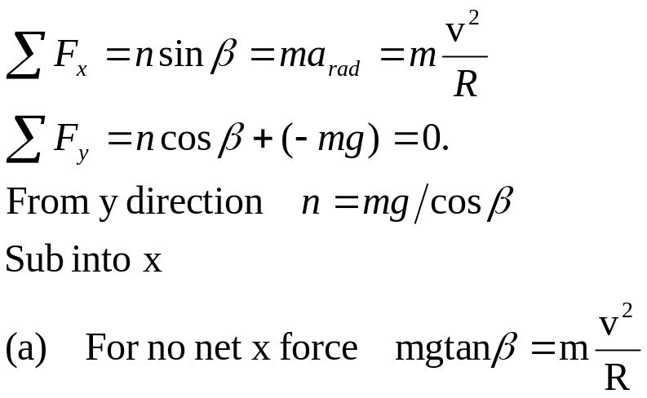
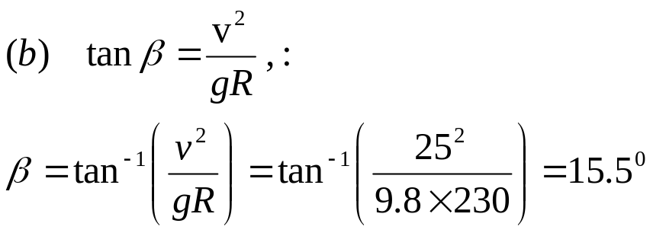
Example 5.23 Rounding a banked curve
a)For a car travelling at a certain speed. It is possible to bank a curve at just the right angle so that no friction at all is needed to maintain the car’s turning radius. Then a car can safely round the curve even on wet ice.
b)If the curve has a radius R=230 m and the car has a speed v=25 m/s, what angle β should the road be banked.
The normal force is perpendicular to the roadway
Notes:
Now let’s apply this to our car going round a bend. We need a force to keep it in the circle of the bend.
Friction can provide this force.

Slide 18
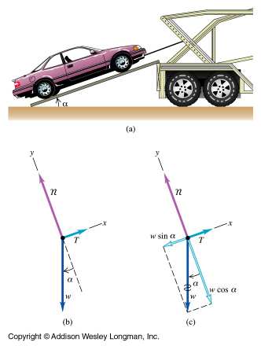
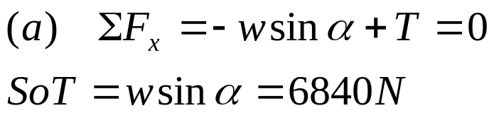
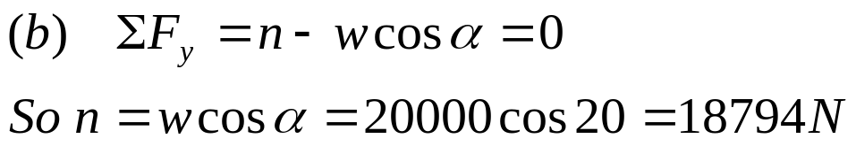
Example 5-4 Car on Ramp
A car rests on the slanted tracks of a ramp. The car is free to roll; only a cable attached to the car and to the frame of the trailer prevents the car from rolling down the ramp. If the car’s weight is 20,000 N and the ramp is at an angle of 20⁰, (a)find the tension in the cable and (b) the force with which the tracks push on the car tyres.
n
T
x
20
mg
Notes:
For this example – its no use resolving forces in x and y direction.
So turn axis around axis- so that x direction is in direction of ramp…

Slide 19
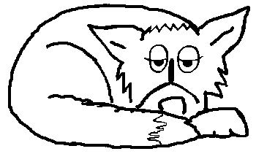
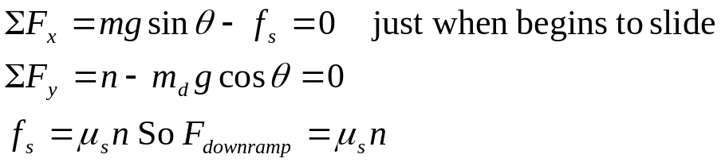
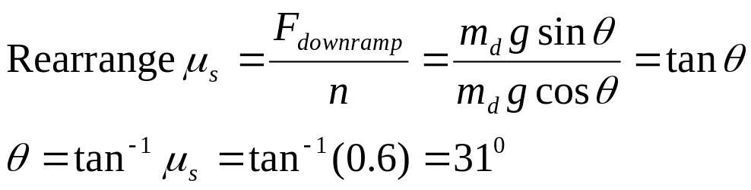
Example: Friction- lazy dog
y
n
f_{s}
θ
mg
A dog is sleeping on a ramp, which you want to use.
If the coefficient of static friction between the dog and the ramp is 0.60,
What angle must you lift the ramp to just slide the dog off.
Hint- resolve dogs weight perpendicular and parallel to the ramp.
θ
F_{d}
x

Slide 20
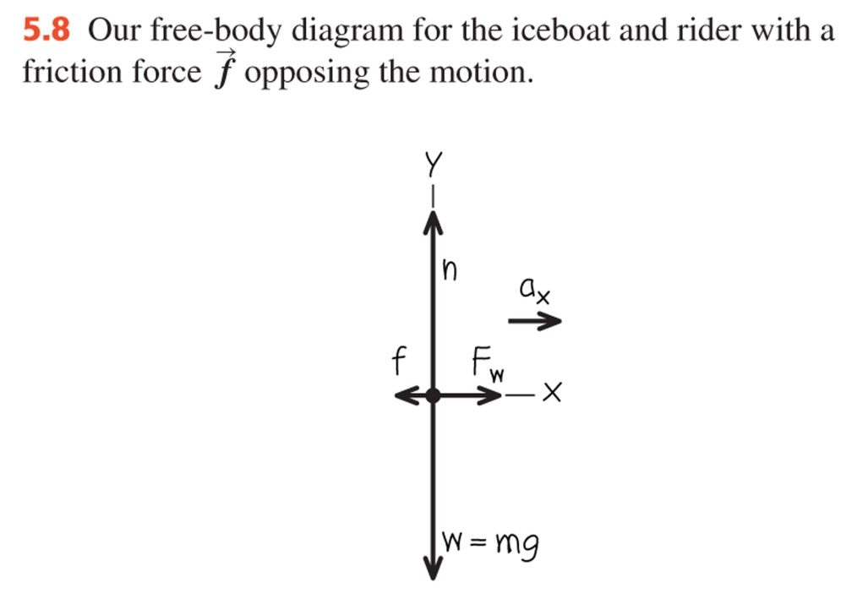
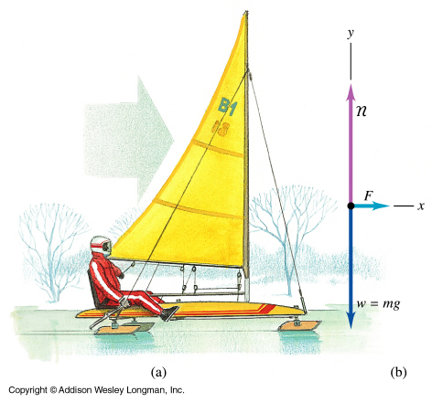
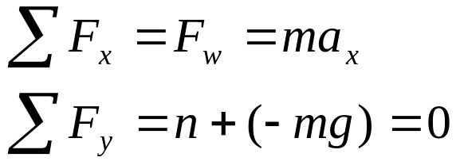
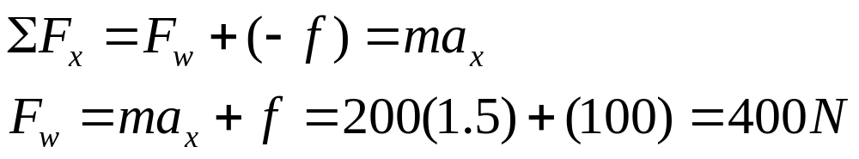
Example 5.7 Straight line with friction
Suppose a constant horizontal friction force with magnitude 100 N opposes the motion of the iceboat.
What constant force F_{w} must the wind exert on the iceboat to cause an acceleration of 1.5 m/s²?

Slide 21
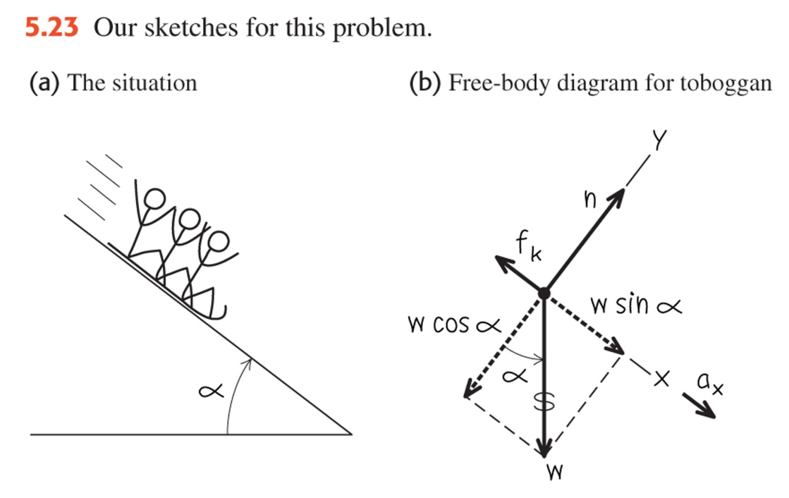
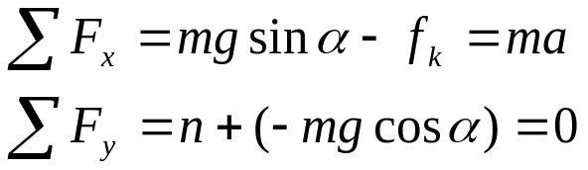
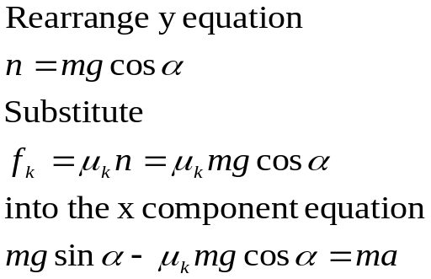
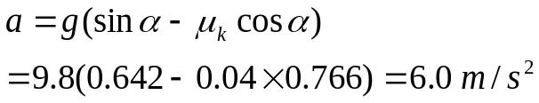
5.17 Tobogganing- Acceleration down a hill with friction
A toboggan with 4 kids on it slides down a long, snow-covered slope. The hill slopes at a constant angle of 40⁰. A friction force acts to oppose this motion with μ_{k} of 0.04, but the toboggan still accelerates. Find the acceleration down the slope if the weight of the 4 kids plus toboggan is 400 kg
Notes:
A toboggan with 4 kids on it slides down a long, snow-covered slope. The hill slopes at a constant angle of 40⁰. A friction force acts to oppose this motion with μ_{k} of 0.04, but the toboggan still accelerates. Find the acceleration down the slope if the weight of the 3 kids plus toboggan is 400 kg
Here is a picture showing what’s happening. SEE SHEET, problem 8 for rest.
GIVE THEN TIME TO DO IT IF GOT TIME

Slide 22
